Slide 1
Training Program Workplace Safety and Health Training on Infectious Diseases, Including COVID-19
Unit 1: Infectious Diseases
Unit 2: COVID-19 (Recognition)
Unit 3: Protect Yourself and Others (Prevention)
Unit 4: Tackling Problems (Abatement)
Developed by K. Grogan Ullah

Slide 2
OSHA Disclaimer
This material was produced under grant number SH-36973-HA1 from the Occupational Safety and Health Administration, U.S. Department of Labor. It does not necessarily reflect the views or policies of the U.S. Department of Labor, nor does mention of trade names, commercial products, or organizations imply endorsement by the U.S. Government.

Slide 3
Unit 1: Infectious Diseases
Introduction

Slide 4
Learning Objectives
Upon completion of this unit, you will:
Understand more about how the flu is transmitted
Understand more about how someone with the flu can spread
it to others
Understand how to protect yourself and others from infectious
diseases

Slide 5
Discussion: Have you ever- ?
Do you know someone who had an infectious disease?
When was the last time you had a cold?
Do you know someone who had the flu? What were the symptoms?
What about Pneumonia?
Did you or the other person go to the doctor?
Image Source: https://www.duarte.com/presentation-skills-resources/important-communicate-empathy-authority
-times-crisis/

Slide 6
How are infectious diseases spread?
Many infectious diseases can be passed from person to person.
Insects or animals can transmit some infectious diseases.
Some infectious diseases can be spread through contaminated food or water.
Image Source: https://physicsworld.com/a/speed-of-spreading-epidemics-is-predicted-using
analytical-technique/

Slide 7
What are some examples of infectious diseases?
Common cold
Influenza (flu)
COVID-19
Chickenpox
HIV/AIDS
S
Image Source: https://www.picpedia.org
/highway-signs/i/infectious-disease.html
Notes:
Other common examples of infectious diseases include polio, herpes, measles, malaria, tuberculosis, and zika.
“Common Infectious Diseases,” HEALTH, University of Utah. https://healthcare.utah.edu/infectiousdiseases/general.php

Slide 8
What causes a cold to spread?
The viruses that cause colds -
Can spread from person to person
Can spread from infected people to others through the air
Can live on your hands
Can also live on doorknobs and eating utensils, glasses, and cups
Image Source: https://eschooltoday.com/common-cold/causes-of-common-cold.html
Notes:
“Common Colds: Protect Yourself and Others.” Centers for Disease Control and Prevention. https://www.cdc.gov/features/rhinoviruses/index.html

Slide 9
How do you protect yourself and others from the common cold?
Wash your hands frequently.
Use soap and water.
Avoid touching your eyes, nose, and mouth with unwashed hands.
Avoid touching, hugging, or kissing people who have a cold.
Avoid sharing eating utensils with people who have a cold.
Image Source: https://www.verywellhealth.com/who-should-not-get-flu-shots-770429
Notes:
“Common Cold: How to Protect Yourself and Others,” Centers for Disease Control and Prevention, https://www.cdc.gov/features/rhinoviruses/index.html

Slide 10
Just for Fun: Test your knowledge of the Flu
Image Source: https://schoolhouseteachers.com/uncategorized/test-your-knowledge-home/

Slide 11
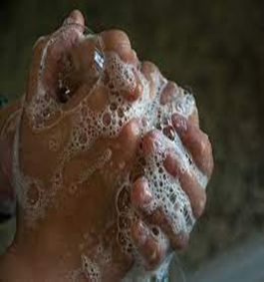
Question number 1
Washing your hands frequently is one way to protect yourself against a cold?
True
False
Image Source: https://www.covenanthealth.com/when-how-to-wash-your-hands/

Slide 12
Answer to #1 - True
Because the viruses can live on your hands, washing your hands with soap and water for at least 20 seconds provides some protection against a cold.

Slide 13
Question number 3
Washing your hands is the best thing you can do to protect against the flu.
True
False

Slide 14
Answer to question #3: False
CDC recommends a flu vaccine as the first and most important step in protecting against the flu. However, preventive actions like covering your mouth when you cough and washing your hands often are important everyday steps that can help stop the spread of germs.

Slide 15
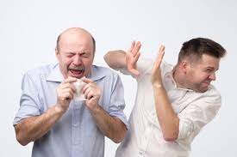
Question number 4
The flu is typically spread through coughs and/or sneezes.
True
False

Slide 16
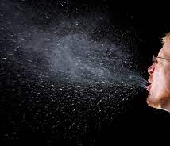
Answer to question #4 - True
The flu virus is mainly spread through droplets from coughs and sneezes.
Image Source: https://first10em.com/aerosols-droplets-and-airborne-spread/
Notes:
“Key Facts about Influenza,” Centers for Disease Control and Prevention, https://www.cdc.gov/flu/about/keyfacts.htm

Slide 17
Unit 2: COVID-19
RECOGNITION

Slide 18
Learning Objectives
Upon completion of this unit, you will:
Understand more about COVID-19 disease
Improve your ability to identify symptoms of COVID-19 infection
Understand more about how the SARS-CoV-2 virus spreads

Slide 19
What is COVID-19?
COVID-19 is a new infectious disease.
It is caused by the SARS-CoV-2 virus.
SARS-CoV-2 is a member of a large family of viruses called coronaviruses.
The World Health Organization first learned about this virus on December 31, 2019.
Image Sorce: https://www.fda.gov/food/food-safety-during-emergencies/food-safety-and-coronavirus-disease-2019-covid-19
Notes:
“COVID-19 Basics,” Harvard Health Publishing. Harvard Medical School. https://www.health.harvard.edu/diseases-and-conditions/covid-19-basics and
“12 Common Myths about COVID,” World Health Organization. https://www.who.int/docs/default-source/searo/thailand/12myths-final099bfbf976c54d5fa3407a65b6d9fa9d.pdf

Slide 20
How many people have died from COVID-19 around the world?
The numbers change rapidly.
As of August 11, 2022:
Worldwide, 6,427,326 people have died from COVID-19.
Image Source: https://www.npr.org/2021/11/01/1051020063/the-covid-19
-pandemic-has-killed-5-million-people-globally
Notes:
“Countries where COVID-19 has spread,” Worldmeter. Accessed March 2, 2022. https://coronavirus.jhu.edu/map.html
See also https://www.worldometers.info/coronavirus/countries-where-coronavirus-has-spread/

Slide 21
What are common early symptoms of COVID disease?
Fever or chills
Cough
Shortness of breath or difficulty breathing
Fatigue
Muscle or body aches
Image Source: https://www.cdc.gov/coronavirus/2019-ncov/symptoms-testing/symptoms.html
Notes:
“Coronavirus Resource Center,” Harvard Health Publishing. Harvard Medical School. https://www.health.harvard.edu/diseases-and-conditions/coronavirus-resource-center

Slide 22
Common early symptoms of COVID disease (continued)
Headache
New loss of taste or smell
Sore throat
Congestion or runny nose
Nausea or vomiting
Diarrhea
Image Source: https://timesofindia.indiatimes.com/life-style/health-fitness/health-news/coronavirus-can-prove-dangerous-for-people-with-these-health-conditions/photostory/77280607.cms
Notes:
“Symptoms of Coronavirus,” WebMD. https://www.webmd.com/lung/covid-19-symptoms#1-2

Slide 23
Does everyone with COVID-19 infection have symptoms?
Occasionally, some people will have no symptoms.
People who have no symptoms can still transmit the virus.
Image Source: https://www.facebook.com/CDC/photos/new-research-shows-
that-more-than-half-of-all-covid-19-cases-are-spread-by-infec/10158787391421026/

Slide 24
When should I seek medical attention?
A person can have mild symptoms for about one week and then worsen rapidly.
If you or someone you know has one or more of these symptoms, you should seek medical attention immediately:
Trouble breathing
Persistent pain or pressure in the chest
New confusion
Inability to wake or stay awake
Pale, gray, or blue-colored skin, lips, or nail beds, depending on skin tone
Image Source: https://unsplash.com/s/photos/covid-19

Slide 25
What underlying conditions increase people’s risk for severe COVID-19?
A few examples of health conditions include:
Diabetes
Heart conditions
Chronic lung diseases such as
COPD (chronic obstructive pulmonary disease)
Chronic kidney disease
Image Source: https://www.cdc.gov/mmwr/volumes/69/wr/mm6924e2.htm
Notes:
“Underlying Medical Conditions Associated with Higher Risk for Severe COVID: Information for Healthcare Providers,” CDC. October 14, 2021. https://www.cdc.gov/coronavirus/2019-ncov/hcp/clinical-care/underlyingconditions.html

Slide 26
Examples of underlying conditions that increase risk of severe COVID (continued)
Obesity
Pregnancy
Smoking (current and former)
Age (risk increases with age)
Hypertension*
Image Source: https://news.yale.edu/2021/04/22/immune-
response-may-pose-greater-risk-pregnant-women-covid-virus
Notes:
High blood pressure is also called hypertension. CDC lists hypertension as “possibly” increasing risk. However, a large number of studies have concluded that there is an increased risk. See: Shah-Abas, Muhamad, et al. “COVID-19 and Hypertension: The What, They Why, and the How,” Frontiers in Physiology. December 2021. https://www.ncbi.nlm.nih.gov/pmc/articles/PMC8126692/

Slide 27
Does COVID-19 affect the lungs?
Some COVID-19 patients will develop severe inflammation in the lungs.
The inflammation can cause swelling of the respiratory system.
The lungs will not be able to perform their normal function.
Our lungs take in oxygen and release carbon dioxide.
Image Source: https://health.clevelandclinic.org/heres-the-damage-
coronavirus-covid-19-can-do-to-your-lungs/
Notes:
Bryce, Emma. “How do lungs work?” Yale School of Medicine. https://medicine.yale.edu/coved/modules/virus/respiratory/ and “Challenge 5: How does COVID-19 affect the respiratory system?” Yale School of Medicine. https://medicine.yale.edu/coved/modules/virus/respiratory/

Slide 28
How does COVID-19 usually spread?
It spreads from contact with an infected person.
It can spread through close contact. The CDC defines “close contact” as 15 minutes or more of contact within six feet of an infected person.
It spreads mostly in crowded settings.
It spreads easily in closed spaces with poor ventilation.
Image Source: https://www.americanprogress.org/article/protecting-farmworkers-coronavirus-securing-food-supply/
Notes:
“Indoor Air and Coronavirus (COVID-19),” United States Environmental Protection Agency, https://www.epa.gov/coronavirus/indoor-air-and-coronavirus-covid-19

Slide 29
How does contact with an infected person transmit the virus?
It spreads through contact with an infected person.
The virus is expelled into the air when an infected person breathes, talks, coughs, sneezes or sings.
Image Source: https://www.news-medical.net/news/20211005/Connection-between-aerosol-transmission-and-
COVID-19-dynamics.aspx

Slide 30
How is COVID Spread Through the Air?
Loud speech can emit thousands of droplets per second.
A cough produces approximately 3,000 droplets.
A sneeze produces approximately 40,000 droplets
Image Source: https://time.com/5820118/coronavirus-questions-answered/
Notes:
Rajiv, Dand and Lie, Jie. “Coughs and Sneezes: Their Role in Transmission of Respiratory Viral Infections, Including SARS-CoV-2,” American Thoracic Society. September 1, 2020. https://www.ncbi.nlm.nih.gov/pmc/articles/PMC7462404/

Slide 31
Why does the SARS-CoV-2 virus spread in enclosed spaces?
Aerosols can float or drift around in the air.
The aerosols can remain suspended in the air.
The aerosols can travel more than six feet.
Image Source: https://www.weforum.org/agenda/2020/04/coronavirus-microdroplets-talking-breathing-spread-covid-19/
Notes:
Stadnytski, Valentyn, et al., “The airborne lifetime of small speech droplets and their potential importance in SARS-CoV-2 transmission,” Proceedings of the National Academy of Sciences of the United States. June 2, 2020. https://www.pnas.org/content/117/22/11875

Slide 32
What common activities put you at higher risk of COVID-19 infection?
Working next to someone who is infected.
Living with someone who is infected.
Travelling in a car or van with someone who is infected.
Talking with an infected person within 6 feet and for longer than 15 minutes.
Image Source: https://www.noozhawk.com/article/public_health_
assess_risk avoiding_coronavirus_activities_santa_barbara

Slide 33
Discussion: Enrique and Marisol
Enrique and Marisol work at the Green Apple Orchard.
Enrique believes that COVID-19 is the same as the flu. He says that he is safe because he eats a lot of garlic. He also says that he heard that people should spray their bodies with chlorine to protect themselves from it. He claims that washing your clothes every day will kill the virus.
Marisol listens to Enrique. She asks him where he got his information. He says he got messages on his phone with the information.
What should Marisol do? What should she say to Enrique?
Notes:
Instructors are encouraged to collect trainee responses. Slide 21 provides an opportunity for trainees to review their responses. See the notes section in slide 21 for background information for the correct responses to the problems.

Slide 34
Discussion: Gabriel and Marisol’s Problem
Gabriel and Marisol work at the Green Apple Orchard. They work next to each other. They sort apples on a conveyor belt.
Marisol tells Gabriel that she is worried about COVID-19.
Gabriel tells Marisol not to worry. He tells her that COVID-19 infection is transmitted through mosquito bites. He offers her some mosquito repellent. He also tells her that drinking alcohol will prevent COVID-19 infection.
What should Marisol say to Gabriel?
Notes:
The following presents background information. - COVID-19 is a respiratory illness and is not spread by mosquitos. See: World Health Organization, “Myth Busters,” https://www.who.int/emergencies/diseases/novel-coronavirus-2019/advice-for-public/myth-busters#:~:text=To%20date%20there%20has%20been,discharge%20from%20the%20nose.

Slide 35
Question number 1
COVID-19 first enters the body through the skin.
True
False
Image Source: https://magazine.ucsf.edu/we-thought-it-was-just-respiratory-virus

Slide 36
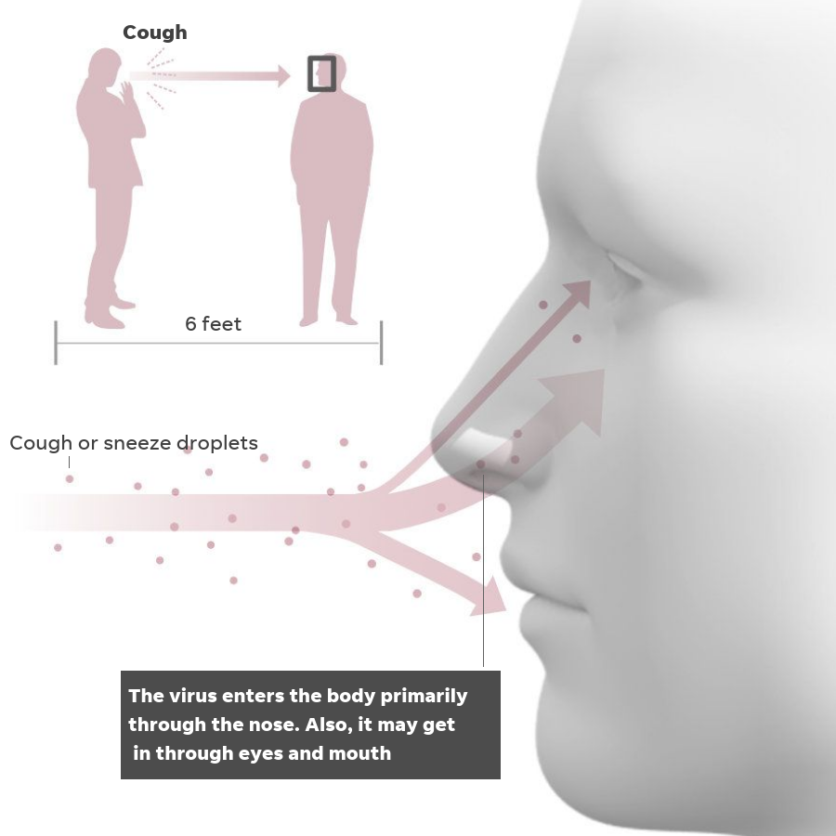
Answer to question # 1 - False
The SARS-CoV-2 virus first enters the body through the nose, mouth, or eyes.
Image Source: https://www.usatoday.com/in-depth/
news/2020/03/13/what-coronavirus-does-body-
covid-19-infection-process-symptoms/5009057002/
Notes:
“Researchers map how coronavirus infection travels through the cells of the nasal cavity and respiratory tract,” Gillings School of Public Health, UNC. https://sph.unc.edu/sph-news/researchers-map-how-coronavirus-infection-travels-through-cells-of-nasal-cavity-and-respiratory-tract/

Slide 37
Question number 2
The SARS-CoV-2 virus is easily transmitted in closed and poorly ventilated spaces.
True
False
Image Source: https://www.cam.ac.uk/research/news/free-online-tool-calculates-risk-of-covid-19-transmission-in-poorly-ventilated-spaces

Slide 38
Answer to question #2 - True
True. The virus can remain suspended in the air in closed and poorly ventilated spaces. People can be infected when they breathe it in.
Image Source: https://www.usatoday.com/story/money/2020/02/18/coronavirus-restaurants-suffer-wary-customers-stay-away/4753280002/
Notes:
“Scientific Brief: SARS-CoV-2 Transmission,” May 7, 2021. Centers for Disease Control and Infection. https://www.cdc.gov/coronavirus/2019-ncov/science/science-briefs/sars-cov-2-transmission.html

Slide 39
Question number 3
You should remain a minimum of 6 feet away from someone and limit the time you speak in-person with someone.
True
False
Image Source: https://www.uchealth.org/today/what-is-social-distancing-you-can-go-outside/

Slide 40
Answer to question #3 - True
True. Having person to person contact less than six feet apart and for longer than 15 minutes increases your risk of infection.
Image Source: https://www.northwestern.edu/coronavirus-covid-19-updates/health/contact-tracing.html
Notes:
“How to Protect Yourself and Others,” Centers for Disease Control and Prevention. https://www.cdc.gov/coronavirus/2019-ncov/prevent-getting-sick/prevention.html#stay6ft%20

Slide 41
Unit 3: Protect Yourself and Others
Prevention

Slide 42
OSHA Disclaimer
This material was produced under grant number SH-36973-HA1 from the Occupational Safety and Health Administration, U.S. Department of Labor. It does not necessarily reflect the views or policies of the U.S. Department of Labor, nor does mention of trade names, commercial products, or organizations imply endorsement by the U.S. Government.

Slide 43
Learning Objectives
Upon completion of this unit, you will improve your understanding of:
How our immune systems protect us from infection
How vaccines train our immune systems to protect us
Vaccines, including their safety
Masks and how they protect us from infection

Slide 44
Learning Objectives (continued)
Upon completion of this unit, you will improve your understanding of:
How our immune systems protect us from infection
How vaccines train our immune systems to protect us
Vaccines, including their safety
Masks and how they protect us from infection

Slide 45
Let’s talk about your experiences with vaccines
Have you ever gotten a vaccine?
If so, what were you vaccinated against?
What happened when you got vaccinated?
How old were you?
Has anyone in your family been vaccinated?
Do you know what he or she was vaccinated against?
Image Source: https://www.freepik.com/free-vector/cartoon-vaccination-campaign-illustration_13859994.htm

Slide 46
How does our immune system defend us?
Germs are everywhere.
Our body has a defense system.
The immune system defends our body against pathogens.
When a pathogen infects our bodies, the immune system attacks the pathogen.
It takes time for the immune system to destroy pathogens.
Image Source: https://www.everydayhealth.com/news/10-amazing-
facts-about-your-immune-system/
Notes:
“The Immune System,” Johns Hopkins Medicine. https://www.hopkinsmedicine.org/health/conditions-and-diseases/the-immune-system
See also: “COVID-19 Breakthrough: Scientists Discover How the SARS-CoV-2 Virus Evades Our Immune System,” SciTechDaily, https://scitechdaily.com/covid-19-breakthrough-scientists-discover-how-the-sars-cov-2-virus-evades-our-immune-system/

Slide 47
How do vaccines help our bodies?
Vaccines teach our bodies how to defend themselves.
Vaccines teach our bodies to build the soldier antibodies that can defend against a specific pathogen.
Image Source: https://www.immunology.org/celebrate-vaccines/public-engagement/guide-childhood-vaccinations/how-vaccines-work
Notes:
“How do vaccines work?” World Health Organization. December 8, 2020. https://www.who.int/news-room/feature-stories/detail/how-do-vaccines-work
Instructors may wish to add that: - Through the vaccine, the antibodies develop a memory of the pathogen.
- Our new antibodies know how to rapidly fight a specific pathogen.
- Our immune system is now ready to defend us against a specific disease.

Slide 48
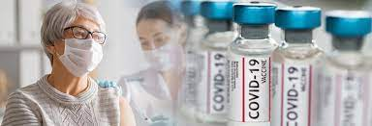
What is the best way to protect yourself from COVID-19?
What do you think?
1. Eat garlic and take vitamin C.
True
False
2. Take antibiotics at the first sign of symptoms.
True
False
3. Get vaccinated.
True
False
Image Source: https://ireallylike
food.com/garlic-and-vitamin-c/
Image Source: https://www.netdoctor.co.uk/medicines/a5573/antibiotics/
Image Source: https://www.phhealthcare.org/about/covid-19-vaccines-at-penn-highlands
Notes:
Answer key: (1) False, (2) False, (3) true
“Eating garlic does not prevent COVID-19,” World Health Organization, https://www.who.int/emergencies/diseases/novel-coronavirus-2019/advice-for-public/myth-busters#:~:text=FACT%3A%20Eating%20garlic%20does,from%20the%20new%20coronavirus.
COVID-19 Frequently Asked Questions /Are antibiotics effective in preventing or treating COVID-19,” Food and Drug Administration, https://www.fda.gov/emergency-preparedness-and-response/coronavirus-disease-2019-covid-19/covid-19-frequently-asked-questions
“OSHA emphasizes that vaccination is the most effective way to protect against severe illness or death from COVID-19…” Quoted from “Protecting Workers: Guidance on Mitigating and Preventing the Spread of COVID-19 in the Workplace,” Occupational Safety and Health Administration, https://www.osha.gov/coronavirus/safework

Slide 49
How long do side effects from the vaccine last?
What do you think?
1. Side effects often last for several months.
True
False
2. Side effects usually start within a day or two of getting the vaccine. They usually go away in a few days.
True
False
3. Side effects can last a lifetime.
True
False
Image Source: https://www.exploregov.ky/coronavirus
-blog/how-long-covid19-vaccine-side-effects-take
Notes:
“How Long Should Vaccine Side Effects Last?” MSN. April 22, 2021. https://www.msn.com/en-us/health/medical/how-long-should-covid-vaccine-side-effects-last/ar-BB1fWXQz
Answer key: (1) False, (2) True, (3) False

Slide 50
How much does it cost to get a COVID-19 vaccine?
What do you think?
The vaccine costs $50 per shot.
True
False
You need insurance to get a vaccine.
True
False
The vaccine is free.
True
False
Image Source: https://www.health.gov.au/resources/publications/
covid-19-vaccine-social-media-image-vaccines-free
Notes:
“COVID-19 vaccines are free for everyone in the U.S.,” CDC. Twitter. https://twitter.com/CDCgov/status/1375100422092902414
and “Frequently Asked Questions about COVID-19 Vaccination,” CDC. https://www.cdc.gov/coronavirus/2019-ncov/vaccines/faq.html

Slide 51
Do I need a social security number to get a COVID-19 vaccine?
What do you think?
“You need a social security number to get a COVID vaccine?”
True
False
Image Source: https://hbr.org/2018/01/the-art-of-strategy-is-about-knowing-when-to-say-no
Notes:
D’Avanzo, Ben, et. al. “Answers to Common Questions about Immigrants’ Access to the COVID-19 Vaccines,” National Immigration Law Center. April 12, 2021. https://www.nilc.org/2021/04/12/immigrant-access-to-the-covid-19-vaccines/

Slide 52
Can someone without a residency permit still get a vaccine?
What do you think?
Yes
No
The Centers for Disease Control and Prevention has stated that the vaccination against COVID-19 disease is available for everyone.
Undocumented immigrants may receive a vaccination.
Image Source: https://www.vaccines.gov/
Notes:
Juarez, Liz, “Alarming Myths Discourage Valley Farmworkers from Getting COVID vaccines,” GV Wire. October 6, 2021. https://gvwire.com/2021/10/06/alarming-myths-discourage-valley-farmworkers-from-getting-covid-vaccines/

Slide 53
Will my personal information be shared with law enforcement or Immigration services?
What do you think?
Yes
No
Information about vaccine recipients may not be given to immigration enforcement.
Image Source: Image Source:
https://hbr.org/2018/01/the-art-of-strategy-is-about-knowing-when-to-say-no

Slide 54
How should I prepare for the vaccination?
Take your usual medications and eat your usual diet on the day you receive the vaccine.
Wear clothes that will give the nurse easy access to your upper arm.
Wear a face mask that covers your mouth and nose.
Image Source: https://www.mclaren.org/main/news/preparing-for-your-covid19-shot-3265

Slide 55
Slow the Spread

Slide 56
Masks
Image Source: https://news.llu.edu/health-wellness/which-type-of-face-mask-most-effective-against-covid-19

Slide 57
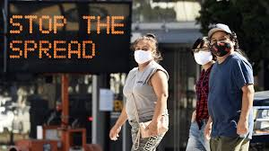
When should I wear a mask?
Wear a mask in areas with high numbers of COVID-19 cases.
Wear a mask when you are in indoors public settings.
Wear a mask if you have close contact with individuals who are not vaccinated.
Image Source: https://medlineplus.gov/ency/imagepages/19946.htm
Notes:
“CDC calls on Americans to wear masks to prevent COVID-19 spread,” CDC. July 14, 2020. https://www.cdc.gov/media/releases/2020/p0714-americans-to-wear-masks.html
and “Use Masks to Slow the Spread of COVID-19,” CDC. https://www.cdc.gov/coronavirus/2019-ncov/prevent-getting-sick/diy-cloth-face-coverings.html

Slide 58
What type of mask should I wear?
Choose a mask that is made with at least two layers of fabric.
You can also make your own mask.
Masks can be made out of cotton or linen fabric.
Masks should fit snugly against sides of your face.
Masks should have a nose wire to prevent leaking out of the top.
Image Source: https://www.businessinsider.com/best-masks-for-coronavirus-chart-2020-9

Slide 59
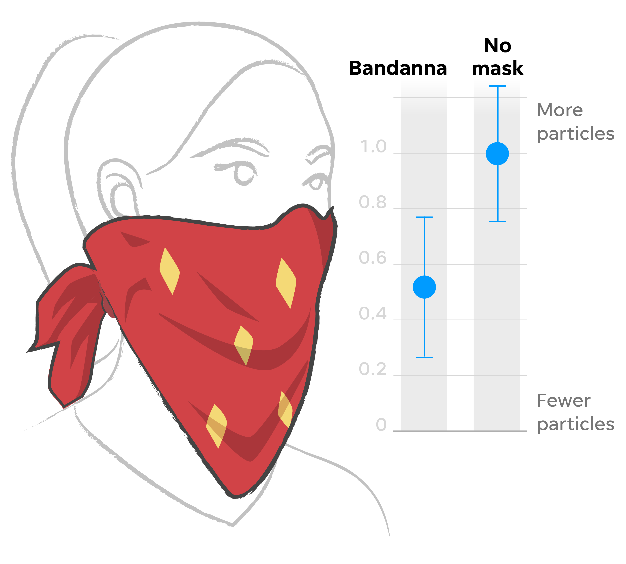
Can I wear a bandana to protect myself and others from COVID-19?
What do you think?
Yes
No
Why?
Bandanas and scarves are not recommended.
A bandana is open at the bottom.
This allows unfiltered air to escape and enter.
Image Source: https://www.usatoday.com/in-depth/news/2020/08/16/
face-masks-what-makes-some-better-than-others-against-covid-19/5535737002/
Notes:
“Instructions on how to make a mask,” Johns Hopkins Medicine. https://www.hopkinsmedicine.org/coronavirus/_documents/INF2003076_VW_Hand-Sewn%20Mask%20instructions-1.pdf

Slide 60
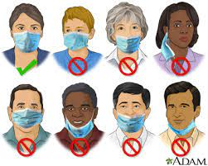
How should I properly wear a mask?
Make sure the mask covers your nose, mouth and chin.
Make sure you can breathe and talk comfortably through the mask.
Image Source: https://medlineplus.gov/ency/imagepages/19946.htm
Notes:
“How to Properly Wear a Face Mask: Infographic,” Johns Hopkins Medicine. https://www.hopkinsmedicine.org/health/conditions-and-diseases/coronavirus/proper-mask-wearing-coronavirus-prevention-infographic

Slide 61
How should I handle my mask?
Touch only the bands or ties when putting on and taking off your mask.
Wash your hands before and after you adjust the mask.
Image Source: https://www.hopkinsmedicine.org/health/conditions-and-diseases/coronavirus/proper-mask-wearing-coronavirus-prevention-infographic

Slide 62
Physical Distancing
Image Source: https://www.safetyandhealthmagazine.com/articles/19578-covid-19-pandemic-tips-to-remain-sane-and-safe-during-social-distancing

Slide 63
When should I keep physical distance to someone?
Always keep 6 feet of distance between yourself and people who don’t live in your house.
Source Image: https://www.gachd.org/new-data-supports-social-distancing-now-more-than-ever/social-distancing-6-feet-featured-image/

Slide 64
Why should we keep 6 feet of distance?
When someone talks, coughs, or sneezes they emit droplets.
The droplets may be infected.
The larger and heavier droplets fall to the ground or other surfaces.
Standing a minimum of 6 feet from an infected person reduces the risk of contact with an infected droplet.
Source Image: https://www.dakotacda.org/wp-content/uploads
/2020/03/Flyer-6-Feet-Social-Distance-Sign-with-CDA-logo.pdf
Notes:
“Scientific Brief: SARS-CoV-2 Transmission,” CDC. Updated May 7, 2021. https://www.cdc.gov/coronavirus/2019-ncov/science/science-briefs/sars-cov-2-transmission.html

Slide 65
Handwashing
Image Source: https://www.healthline.com/health/7-steps-of-handwashing

Slide 66
Why is it important to wash our hands?
Germs can get onto your hands when you blow your nose, cough, or sneeze into your hands.
Germs can get onto your hands when you shake hands with someone.
Germs can get onto your hands when you touch a surface.
Germs can enter your body when you touch your eyes, nose, and mouth with unwashed hands.
Image Source: https://www.businessinsider.com/coronavirus-
photos-why-you-should-wash-hands-with-soap-water-2020-3

Slide 67
What is the best way to wash my hands?
What do you think? Please explain.
Wet your hands with clean, running water (warm or cold), turn off the tap, and apply soap.
Lather your hands by rubbing them together with the soap.
- Lather the backs of your hands, between your fingers, and under your nails.
Scrub your hands for at least 20 seconds.
Rinse your hands well under clean, running water.
Dry your hands using a clean towel or air dry them.
Image Source: https://www.cdc.gov/handwashing/when-how-handwashing.html
Notes:
“When and How to Wash Your Hands,” CDC. https://www.cdc.gov/handwashing/when-how-handwashing.html

Slide 68
Travel
Image Source: https://blogs.worldbank.org/transport/covid-19-could-help-
latin-america-accelerate-toward-more-inclusive-transport
Notes:
“Coronavirus (COVID-19) vaccinations.” Our World in Data. Accessed November 10, 2021. https://ourworldindata.org/covid-vaccinations?country=OWID_WRL

Slide 69
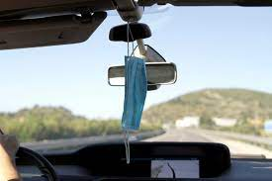
What should we do when traveling in a van?
What do you think?
Wear a mask. Politely ask others to wear a mask.
Allow fresh air to enter the van.
Avoid touching your mouth, eyes, or nose.
If possible, politely encourage fellow passengers to avoid speaking.
Wash your hands or use hand sanitizer after the trip.
Image Source: https://www.wbur.org/hereandnow/
2020/07/28/road-trip-safety-coronavirus
Notes:
Fresh air can be increased by opening the windows or asking the driver to open the van’s vents.

Slide 70
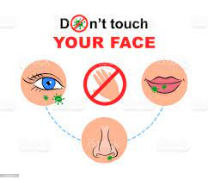
Why should I avoid touching my eyes, nose or mouth with unwashed hands?
What do you think?
Germs can be on your hands.
Germs can enter your body through the eyes, nose, or mouth.
Image Source: https://www.istockphoto.com/vector/do-not-touch-your-face-do-not-touch-hands-eyes-nose-mouth-coronavirus-covid-19-gm1246325374-363176916

Slide 71
Respiratory Hygiene
Image Source: https://timesofindia.indiatimes.com/videos/lifestyle/health-fitness/how-to-maintain-respiratory-hygiene/videoshow/74724419.cms

Slide 72
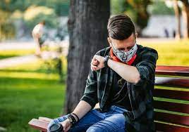
What should we do if we must sneeze or cough while wearing a mask?
What do you think?
Turn your head into your elbow.
Do not remove your mask.
Sneeze into your mask.
Throw the mask into a trash can.
Replace your mask with a fresh mask.
Wash your hands.
Image Source: https://www.verywellhealth.com/allergy-symptoms-vs-covid-symptoms-5118462
Notes:
“Coughing and Sneezing,” CDC. https://www.cdc.gov/healthywater/hygiene/etiquette/coughing_sneezing.html

Slide 73
What should we do if we must sneeze or cough without a mask on?
If possible, try to cough or sneeze outdoors.
Turn your head away from other people.
Cover your mouth or nose with a tissue when you cough or sneeze.
Throw the used tissues in a trash can.
Wash your hands.
Image Source: https://diamondcelebrities.org/2018/01/27/health-zone-
cough-sneeze-in-your-elbow-not-handkerchief-to-stay-healthy

Slide 74
Unit 4: Tackling Problems
Abatement

Slide 75
Learning Objectives
Upon completion of this unit, you will improve your ability to:
Make informed decisions about the vaccine
Respond to misinformation
Engage other people to slow the spread of infectious diseases
File a complaint with OSHA

Slide 76
Isabella and Maria at Work
Isabella and Maria work at Vegetables Are Us.
Isabella does not feel very well. She has a slight fever. She decides to go to work. She cannot afford to miss work. Several days ago, she began feeling bad. Her body ached and she had a slight headache.
Maria works next to Isabella. They are friends. They have lunch together everyday.
Yesterday, Isabella complained that she had a sore throat.
Today, Maria notices that Isabella is coughing and sneezing.
What should Maria do? What should Isabella do?
Notes:
Recommended responses:
CDC recommends that “All employees should stay home if they are sick until at least 24 hours after their fever (temperature of 100 degrees Fahrenheit or 37.8 degrees Celsius or higher) is gone…CDC [also] recommends that workers who have flu symptoms upon arrival to work or become ill during the day should promptly separate themselves from other workers and go home until at least 24 hours after their fever is gone without the use of fever-reducing medications, or after symptoms have improved (at least 4-5 days after flu symptoms started).”
“Stay Home When You Are Sick,” Centers for Disease Control and Prevention, https://www.cdc.gov/flu/business/stay-home-when-sick.htm
Maria should maintain physical distance from Isabella, if possible. She should ensure that her mask fits tightly. She could consider double masking. She should avoid hugging or touching Isabella. She should avoid touching her mouth, nose, and eyes. She should disinfect common surfaces touched by Isabella. She should ask Isabella to go home. Maria could also report Isabella to her supervisor.
Isabella should go home, if possible. She should seek a COVID-19 test. If she cannot go home, she should wear a mask, maintain physical distance from others, follow proper respiratory hygiene procedures, and disinfect surfaces that she has touched.

Slide 77
Enrique and Marisol
Enrique and Marisol work at the Green Apple Orchard. Marisol is vaccinated. Enrique is not vaccinated.
Enrique believes that COVID-19 is the same as the flu. He says that he is safe because he eats a lot of garlic. He also says that he heard that people should spray their bodies with chlorine to protect themselves from it. He claims that washing your clothes every day will kill the virus.
Marisol listens to Enrique. She asks him where he got his information. He says he got messages on his phone with the information.
What should Marisol do? What should she say to Enrique?
Notes:
Recommended responses:
Marisol can share her experiences of receiving the vaccine and how the vaccination has benefited her life. She should explain her motivation for getting the vaccine.
Marisol could also share that eating garlic and spraying oneself with chlorine will not protect one from COVID-19 infection.
See: “Confronting Vaccine Misinformation in the Workplace,” SHRM, https://www.shrm.org/resourcesandtools/hr-topics/people-managers/pages/covid-vaccine-misinformation-.aspx
See also: World Health Organization, “Coronavirus disease (COVID-19) advice for the public: Mythbusters, https://www.who.int/emergencies/diseases/novel-coronavirus-2019/advice-for-public/myth-busters
See also, “Public Health Disinformation Panel, December 8, 2021,” County of San Diego, https://www.youtube.com/watch?v=lAKxTbV7Idk&t=466s

Slide 78
Gabriel and Elena’s Problem
Gabriel and Elena also work at the Green Apple Orchard. They work next to each other. They sort apples on a conveyor belt.
Elena tells Gabriel that she is worried about COVID-19.
Gabriel tells Elena not to worry. He tells her that COVID-19 infection is transmitted through mosquito bites. He offers her some mosquito repellent. He also tells her that drinking alcohol will prevent COVID-19 infection.
What should Elena say to Gabriel?
Notes:
Recommend responses:
Elena could respond that the best protection against COVID-19 infection is to get vaccinated. Elena could share the reasons why she chose to get vaccinated. She could also share that there is no evidence that mosquitoes transmit coronavirus.
According to the World Health Organization, “To date there has been no information nor evidence to suggest that the new coronavirus could be transmitted by mosquitoes. The new coronavirus is a respiratory virus which spreads primarily through droplets generated when an infected person coughs or sneezes, or through droplets of saliva or discharge from the nose. To protect yourself, clean your hands frequently with an alcohol-based hand rub or wash them with soap and water. Also, avoid close contact with anyone who is coughing and sneezing.” World Health Organization, “Coronavirus disease (COVID-19) advice for the public: Mythbusters,” https://www.who.int/emergencies/diseases/novel-coronavirus-2019/advice-for-public/myth-busters#:~:text=To%20date%20there%20has%20been,discharge%20from%20the%20nose.

Slide 79
Camila and Valentina’s problem
Camila and Valentina work on the farm. They pick lettuce. One day Camila tells Valentina that she wants to have a baby. She says that she is afraid to get the vaccine against COVID-19. She says that it will make her infertile. She also says that she heard the vaccine is dangerous. She says many people have died from it. She says that people get dangerous allergic reactions.
What should Valentina say?
Notes:
Recommended response:
Valentina could explain that there is no evidence that the COVID vaccine will cause infertility. She could also share why she got vaccinated or plans to get vaccinated. “Does the COVID-19 Vaccine Affect Fertility? Here’s What the Experts Say,” MU Healthcare, https://www.muhealth.org/our-stories/does-covid-19-vaccine-affect-fertility-heres-what-experts-say
She could also explain that, according to the CDC, “There is currently no evidence that any vaccines, including COVID-19 vaccines, cause fertility problems (problems trying to get pregnant) in women or men.”
“COVID-19 Vaccines for People Who Would Like to Have a Baby,” Centers for Disease Control and Prevention, https://www.cdc.gov/coronavirus/2019-ncov/vaccines/planning-for-pregnancy.html
She might want to mention that, according to the Henry Ford Health System, ““Women who participated in the COVID-19 clinical trials were able to conceive after vaccination," says Dr. Pitts. "We also have many patients here at Henry Ford who got vaccinated and then became pregnant afterwards. Some are in their first trimester, some are now in their second trimester. There’s no evidence to show that the COVID-19 vaccines lead to reduced fertility.” Henry Ford Health System, https://www.henryford.com/blog/2021/04/fertility-rumor-covid-vaccine
She could also explain that, according to the CDC, “People who are pregnant or recently pregnant are at an increased risk for severe illness from COVID-19 when compared to people who are not pregnant; and that people who have COVID-19 during pregnancy are also at increased risk for preterm birth (delivering the baby earlier than 37 weeks) and stillbirth and might be at increased risk for other pregnancy complications.”
“Investigating the Impact of COVID-19 during Pregnancy,” Center for Disease Control and Prevention, https://www.cdc.gov/coronavirus/2019-ncov/cases-updates/special-populations/pregnancy-data-on-covid-19/what-cdc-is-doing.html#:~:text=>People%20who%20have%20COVID,for%20other%20pregnancy%20complications.
She may want to also explain that in one study that “newborns whose mothers received either the Pfizer–BioNTech or Moderna COVID-19 vaccine during pregnancy found that 100 percent of the infants had protective antibodies at birth.”
“Pregnant Women Who Receive COVID-19 Vaccination Pass Protection from the Virus to Their Newborns,” NYU Longone Health, https://nyulangone.org/news/pregnant-women-who-receive-covid-19-vaccination-pass-protection-virus-their-newborns

Slide 80
Daniela and Mia’s problem
Daniela and Mia are sisters. Daniela was born in the United States. Mia is older than Daniela. She was ten years old when her parents brought her to the United States. Mia is undocumented.
Daniela and Mia would like to get vaccinated.
Mia is afraid to go to the pharmacy. She says that she heard that the pharmacy gives people’s names and addresses to Immigration. She says her friend told her that you need a social security number to get vaccinated.
What should Daniela say to Mia?
Notes:
Recommended response:
Daniela could explain that “the Centers for Disease Control and Prevention (CDC) has stated that vaccines are available to anyone, including undocumented immigrants, without regard to their immigration status.”
“Answers to Common Questions about Immigrants’ Access to the COVID-19 Vaccines,” National Immigration Law Center, https://www.nilc.org/2021/04/12/immigrant-access-to-the-covid-19-vaccines/

Slide 81
Diego and Antonio’s problem
Diego and Antonio are best friends. Diego knows that Antonio is afraid of needles. Antonio tries to act brave. But Diego knows. Two years ago, they got tetanus shots. Antonio almost fainted when he saw the needle.
What should Diego say?
Notes:
Recommended response:
Diego could go with Antonio to the vaccination clinic. He could also suggest that Antonio look away when he gets the jab. He could say that the jab is momentary, but the protection from the vaccine could say his life. He could also tell him to tense his abdominal and arm muscles to raise his blood pressure when getting the jab.
“Techniques to Help You Overcome a Fear of Needles,” Cedars Sinai, https://www.cedars-sinai.org/blog/techniques-to-overcome-fear-of-needles.html

Slide 82
Jose and Alejandrina’s problem
Jose and Alejandrina are married. Alejandrina would like them to wear masks. Jose Louis does not think masks are important to wear.
What should Alejandrina say?
Notes:
Recommended response:
Alejandrina could tell Jose that masks help protect those around you. She could explain that many people have COVID-19 but do not have symptoms and that there is a danger that they could pass it on. She could also explain that masks provide some protection to the wearer.
“Guidance for Wearing Masks,” Centers for Disease Control and Prevention, https://www.cdc.gov/coronavirus/2019-ncov/prevent-getting-sick/cloth-face-cover-guidance.html

Slide 83
Jose, Alejandrina, and Martha’s problem
Jose agrees to wear a mask. Alejandrina is relieved. They don’t know what kind of mask to buy? They also don’t know when they should wear a mask.
Martha and Alejandrina are sisters. Martha learned about masks at a training session. Martha and Alejandrina ask Martha for advice.
What does Martha tell Alejandrina and Jose Louis?
Notes:
Recommended response:
Martha could tell them to choose a mask with a nose wire, use a mask fitter or brace over a disposal or cloth mask, check that it fits snugly over nose, mouth, and chin, use a cloth mask that has more than one layer of fabric, wear a disposal mask underneath a cloth mask.
See: “Guidance for Wearing Masks,” Centers for Disease Control and Prevention,” https://www.cdc.gov/coronavirus/2019-ncov/prevent-getting-sick/cloth-face-cover-guidance.html#anchor_1604966572663
“Face Coverings,” San Diego County, https://www.sandiegocounty.gov/content/sdc/hhsa/programs/phs/community_epidemiology/dc/2019-nCoV/face-coverings.html

Slide 84
Jose Louis and Enrique’s problem
Jose Louis wears his new mask at work. Jose Louis works with Enrique. They work at a poultry processing company.
Enrique doesn’t like masks. One day his boss tells him he must wear a mask.
Enrique only covers his mouth with the mask. He says he needs to breathe through his nose. His mask is very loose. His boss tells him he should wear it properly. The boss then leaves.
Enrique asks Jose Louis to explain to him how to properly wear a mask.
What does Jose Louis say?
Notes:
Recommended response:
Jose Louis could explain that masks should cover the nose, mouth, and chin. It should fit snugly against the face. There should not be any gaps that allow air in or out the edges of the mask. Men with beards should trim their beards close to their face or wear a disposable mask under the cloth mask.
See: “Guidance for Wearing Masks,” Centers for Disease Control and Prevention,” https://www.cdc.gov/coronavirus/2019-ncov/prevent-getting-sick/cloth-face-cover-guidance.html#anchor_1604966572663
“Face Coverings,” San Diego County, https://www.sandiegocounty.gov/content/sdc/hhsa/programs/phs/community_epidemiology/dc/2019-nCoV/face-coverings.html

Slide 85
Carlos and Miguel’s problem
Carlos and Miguel work at Tito’s Big Produce. Carlos often shouts across the room. He likes to shout. He always pulls his mask down when he shouts. He likes to stand close to people and shout.
What should Miguel say to him?
Notes:
Recommended response:
Carlos could explain to Miguel that his mask should remain over his mouth and nose when he speaks. He could explain that if he has the coronavirus, it can be passed to others through the droplets given off when we speak, sneeze, cough, and breathe. He could also explain that shouting possibly releases more particles than speaking at a normal volume.
According to one study, “particles expelled during human expiratory events, such as sneezing, coughing, talking, and breathing, serve as vehicles for respiratory pathogen transmission…the rate of particle emission during normal human speech is positively correlated with the loudness (amplitude) of vocalization, ranging from approximately 1 to 50 particles per second (0.06 to 3 particles per cm³) for low to high amplitudes, regardless of the language spoken (English, Spanish, Mandarin, or Arabic).”
See: “Aerosol emission and superemission during human speech increase with voice loudness,” Sima Asadi et al, https://www.ncbi.nlm.nih.gov/pmc/articles/PMC6382806/

Slide 86
Rafael, Teresa, and Maria’s problem
Rafael, Teresa, and Maria work together. Rafael and Teresa are married. Maria and Teresa are sisters.
Maria and Teresa notice that Rafael has a bad cold. He often sneezes and coughs. He tries to covers his mouth and nose with his hand. Maria is worried.
The bathroom is far away from where they work. Rafael only washes his hands when they get home from work. Maria notices that Rafael always shakes his friend’s hands.
What should Maria and Teresa say to Rafael?
Notes:
Recommended response:
Maria and Teresa could explain to Rafael that he should sneeze into a tissue and then throw it away. He could wear a disposable mask and sneeze into the mask. He should turn his head away from others. Afterwards, he should wash his hands with soap and water for at least 20 seconds or use a hand sanitizer. He should avoid shaking hands with others.
See: “Coughing and Sneezing,” Centers for Disease Control and Prevention, https://www.cdc.gov/healthywater/hygiene/etiquette/coughing_sneezing.html

Slide 87
Francisco, Juan, and Rosa’s problem
Francisco, Juan, and Rosa ride together in a van to work every day . They ride with five other people.
They always wear their masks. Some people don’t wear a mask. They are worried about COVID-19.
They know the driver.
What should they say to the driver? How can they make the ride safer?
Notes:
Recommended response:
Francisco, Juan, and Rosa could try to open a window. They can also ask the driver to open the van’s vents. They could ask the driver if the company can provide masks to riders. They could also ask the riders to wear masks. They should also make sure that they wash their hands after the trip.
See: “Is there coronavirus in your car? Here's how you can protect yourself,” Joseph Allen et al. USA Today. https://www.usatoday.com/story/opinion/2020/04/22/coronavirus-car-protect-yourself-column/5166146002/

Slide 88
Whistleblower Protections

Slide 89
What if?
What can you do if your employer is not interested in preventing COVID-19 or other infectious diseases at the workplace?

Slide 90
OSHA
Did you know that the United States government has an agency that is dedicated to protecting workers?
The name of the agency is OSHA.
OSHA stands for Occupational Safety and Health Administration.

Slide 91
Your right to file a complaint
Did you know that you have the right to file a complaint with OSHA?
Did you know that it is against the law for your employer to retaliate against you for filing a complaint?

Slide 92
5 Ways to File a Complaint with OSHA
Online – Use the online complaint form
Call your local OSHA office (or 800-321-6742)
In person – visit your local OSHA office
Email or fax
Mail – send a letter
Notes:
See: “File a Complaint,” U.S. Department of Labor, https://www.osha.gov/workers/file-complaint

Slide 93
How to file a complaint with OSHA
Watch the OSHA presentation on how to file a complaint OSHA Presentation (https://www.youtube.com/watch?v=plrX7JU_8x0)
Or with Spanish subtitles OSHA Presentation with Spanish subtitles (https://www.youtube.com/watch?v=EsoFu3qcmz0.

Slide 94
You can access the complaint forms by linking below:
(English) “Notice of Alleged Safety or Health Violation” (https://www.osha.gov/oshforms/osha7.pdf)
(Spanish) “Notificación de una Queja en Seguridad y Salud” (https://www.osha.gov/oshforms/OSHA7_SPANISH.pdf)

Slide 95
Section 11(c) of the OSH Act
“No person shall discharge or in any manner discriminate against any employee because such employee has filed any complaint or instituted or caused to be instituted any proceeding under or related to this Act or has testified or is about to testify in any such proceeding or because of the exercise by such employee on behalf of himself or others of any right afforded by this Act.”

Slide 96
What if the employer discriminates or retaliates against after you file a complaint?
If an employee believes they have been discriminated against in violation of section 11(c) –
The employee has 30 days after the violation to lodge a complaint with the Secretary of Labor

Slide 97
Let’s File a Complaint
Describe the hazard.
How many people are affected?
Did you bring it to the attention of your employer?
Did you report it to another government agency?
Notes:
Trainers should note that OSHA does not tell the employer who made the complaint.

Slide 98
Our Local OSHA Office
Harrisburg Area Office
U.S. Department of Labor - OSHA 43 Kline Plaza Harrisburg, PA 17104-1529
(717) 782-3902
Philadelphia Area Office
U.S. Department of Labor - OSHA 1835 Market Street Mailstop OSHA-AO/21 Philadelphia, PA 19103
(215) 597-4955
Notes:
See: https://www.osha.gov/contactus/bystate/PA/areaoffice

